Slide 1


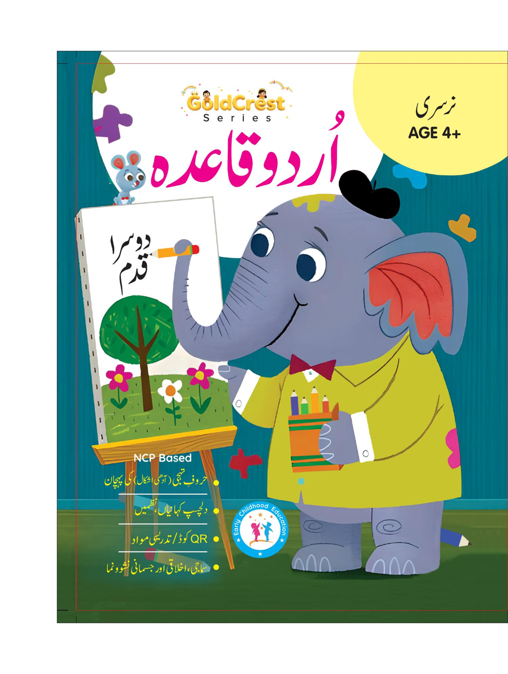
GoldCrest Urdu Qaida
Nursery • Age 4+
An activity-based early-years book from the GoldCrest Series.
A Project of Azhar Publishers & Book Factory

Slide 2
i
What's Inside
GoldCrest Urdu Qaida Nursery • Age 4+
1
The Urdu alphabet (huroof-e-tahajji)
2
Letter sounds and key words
3
Beautiful Urdu poems (nazmein)
4
Letter-joining practice
5
Personal, social & emotional development
6
Revision and assessment

Slide 3
★
Purpose & Classroom Support
Introduces the Urdu alphabet, sounds and early reading — the first step of the Qaida journey.
“
Every book comes with
1
2
3
Teacher's Lesson Plan
Practice Papers
Digital Interactive Version
A 40-week lesson plan that guides teachers, day by day.
Monthly tests and term exam papers for children to attempt.
An interactive flipbook and digital exercises for engaging, screen-based practice.
A Project of Azhar Publishers & Book Factory

